Slide 1

Presentation on Home automation system
Engineering, Pashchimanchal Campus ...
ioepas.edu.np
Presented by:
Amit Patel(pas076bel003)
Amrit Subedi (pas076bel005)
Deepak Adhikari(pas076bel016)
Sanjay Mani Poudel(pas076bel033)
Sarbajit Poudel(pas076bel034)
Sushant Dhakal (pas076bel045)
Submitted to :
Department of Electrical Engineering

Slide 2
Content
Introduction
Objectives
Project modules
Automatic door opening System
Hardware Component required
Software Components
Flowchart
Overall diagram
Simulation Circuit
Advantages
Application
Conclusion
Budget
References

Slide 3
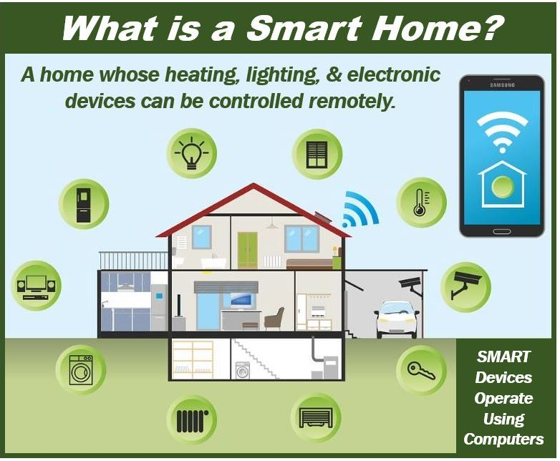
Home Automation System
Our project is divided into four parts:
Home automation system
Door locking system
App development
Web development

Slide 4
Introduction
Home automation system simply helps to control the switch as usual the normal switch but only difference is that the normal used we used in home are manual but the switch we used in home automation system is controlled by mobile application and automatic.
Moreover the home automation system is based on controlling the switch of whole house or building which is not possible by using normal switch.
For e.g.: if you want to off the light of kitchen living in bedroom it is not possible in simple normal switch but using home automation system we can do the task easily.

Slide 5
LITERATURE REVIEW
A home automation system means to grant the end users to manage and handle the electric appliances. If we look at different home automation systems over time, they have always tried to provide efficient, convenient, and safe ways for home inhabitants to access their homes. Regardless of the change in user’s hope, growing technology, or change of time, the appearance of a home automation system has remained the same.

Slide 6
Bluetooth based HAS
In Bluetooth based home automation system the home appliances are connected to the Arduino BT board at input output ports using relay. The program of Arduino BT board is based on high level interactive C language of microcontrollers; the connection is made via Bluetooth. The password protection is provided so only authorized user is allowed to access the appliances. The Bluetooth connection is established between Arduino BT board and phone for wireless communication. In this system the python script is used and it can install on any of the Symbian OS environment, it is portable. One circuit is designed and implemented for receiving the feedback from the phone, which indicate the status of the device.

Slide 7
Wi-fi based HAS
Wi-Fi based home automation system mainly consist three modules, the server, the hardware interface module, and the software package. Wi-Fi technology is used by server, and hardware Interface module to communicate with each other. The same technology uses to login to the server web-based application. The server is connected to the internet, so, remote users can access server web-based application through the internet using compatible web browser. Software of the latest home automation system is split to server application software, and Microcontroller (Arduino) firmware.

Slide 8
Raspberry pie HAS using smart phone
Home Automation System has been developed with Raspberry Pi by reading the algorithm and subject of E-mail. Raspberry Pi guarantees to be an efficient platform for implementation powerful, and economic smart home automation. home automation using Raspberry pi is better than any other home automation methods in several ways. For example, DTMF (dual tone multi-frequency) using home automation, the call tariff is a big demerit, which is not the problem in their proposed method. In Home Automation using web server, the design of web server and the memory space required is dismiss by this method, because it just uses the already established web server service given by G-mail. LEDs were used to identify the switching action. This System is efficient and flexible interactive.

Slide 9
Objectives
The main objective of home automation is to help handicapped and old aged people who will enable themselves in controlling home appliances.
The System will also sense the Accidental Gas leakage , water level and will notify the user by SMS.
The automation system will have the ability to be controlled from a central host PC, the Internet, and also remotely accessed via a Pocket PC with a Windows Mobile based application.
The goal of this project is to develop a home automation system that gives the user complete control over all remotely controllable aspects of his or her home.

Slide 10
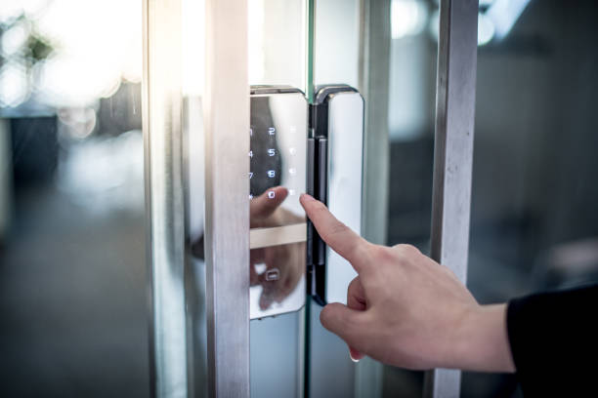
Automatic door opening system
Automatic door opens when the door controller receives an activation signal by the sensor and activate the gear motor to drive the belt and pulley. When no one is detected inside the activation area, the door starts closing after a designated period of time.

Slide 11
Project Modules
Modules is divided into two parts:
a. Hardware
b. Software
Hardware module:
This module is based on using the hardware components which can control the given module. The hardware module are similar we use in other related proteus and Arduino module.
B. Software module:
This module is based on coding and programming for the given task. This is the main part and principle for given module

Slide 12
Hardware Components Required
Node MCU
Arduino ide
Relay module
Remote
Servo Motor
Arduino Uno
Keypad
Battery
Electric components
1.Wires 2. Electric bulbs
3.Fan

Slide 13
Remote
Remote is simply a controller like tv remote which control tv in which tv must be in receiving mode and remote must be in sending mode likewise we will make remote app which will control all the home switching system.
This will help us to get control over the switching system automatically.

Slide 14
Node MCU
Node MCU is an open source firmware for which open source prototyping board designs are available. The name "Node MCU" combines “node" and "MCU" (micro-controller unit).The term "Node MCU" strictly speaking refers to the firmware rather than the associated development kits.

Slide 15
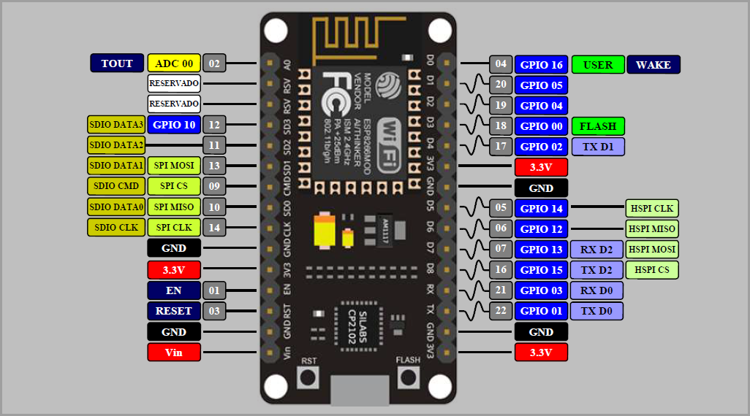

Slide 16
Relay and Relay module
A power relay module is an electrical switch that is operated by an electromagnet. The electromagnet is activated by a separate low-power signal from a micro controller. When activated, the electromagnet pulls to either open or close an electrical circuit.

Slide 17
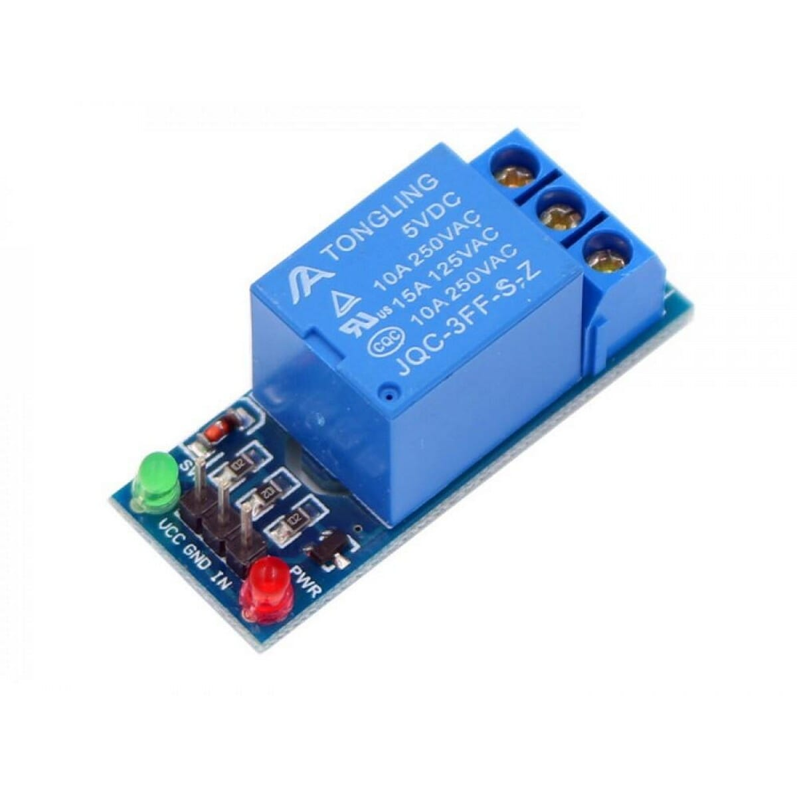
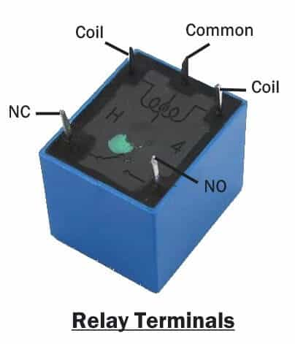

Slide 18
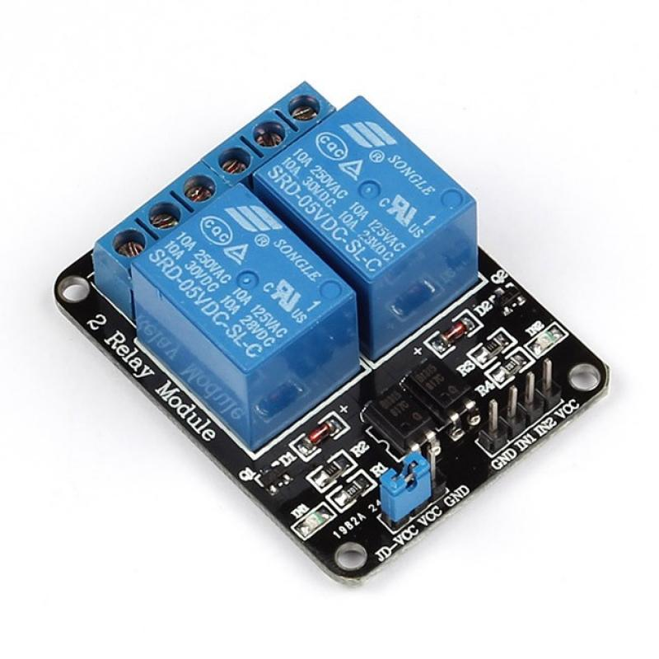
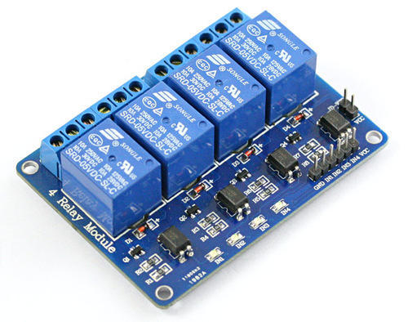
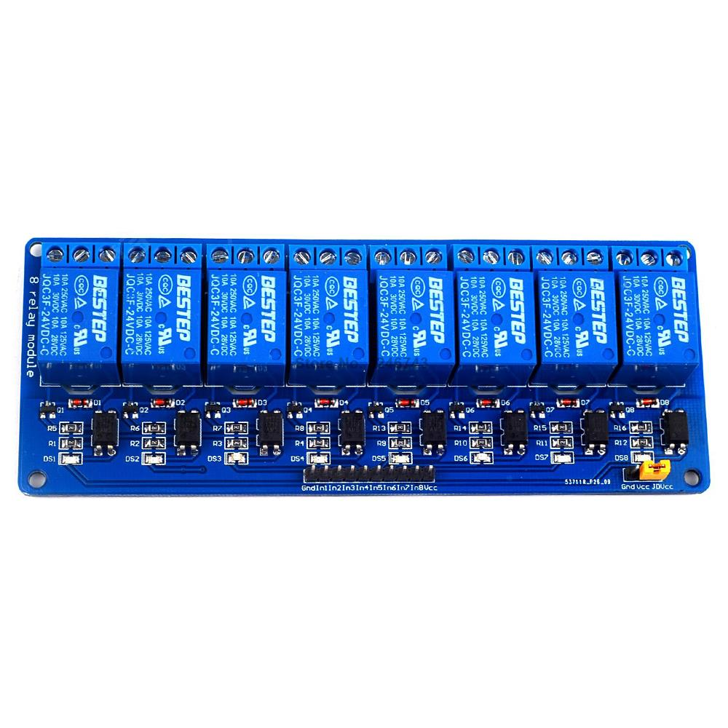

Slide 19
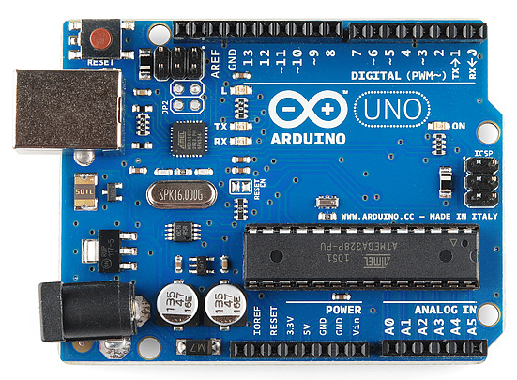
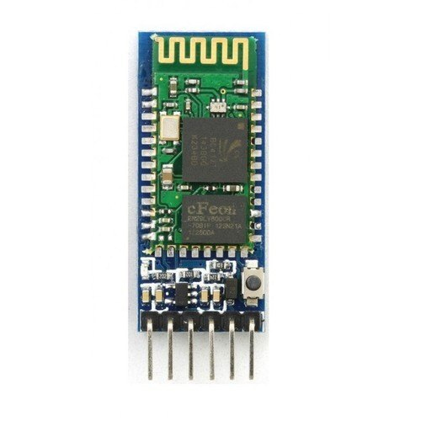
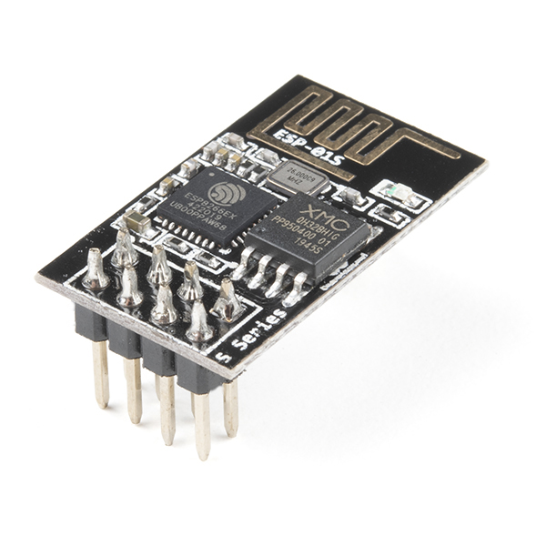
Other devices
Arduino
Bluetooth module
Wifi module

Slide 20
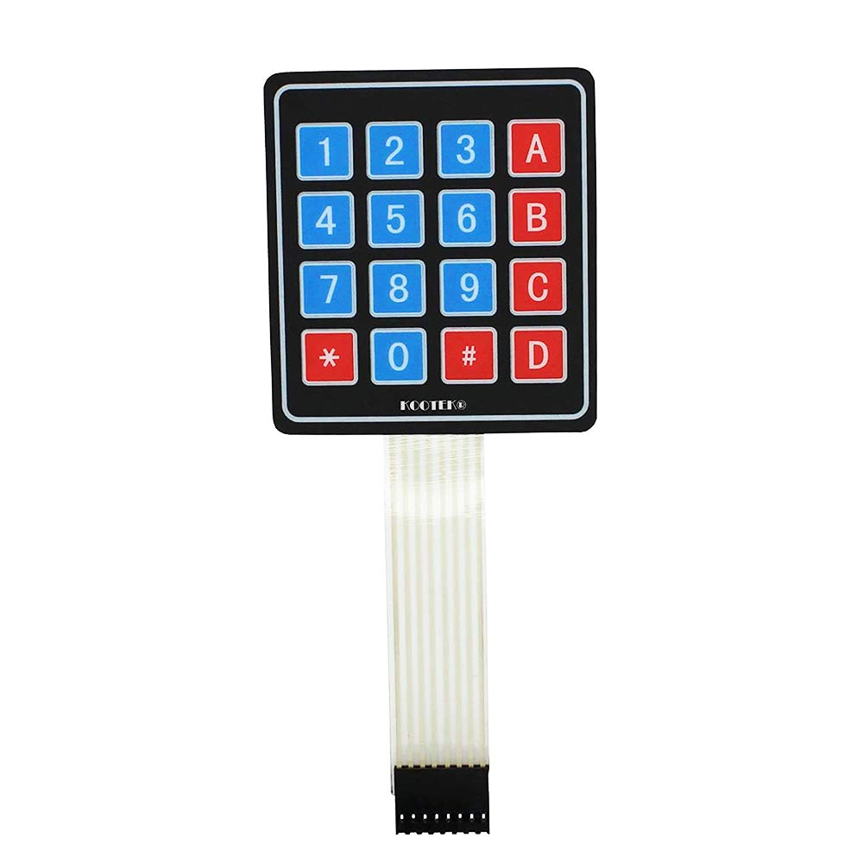
Keypad

Slide 21
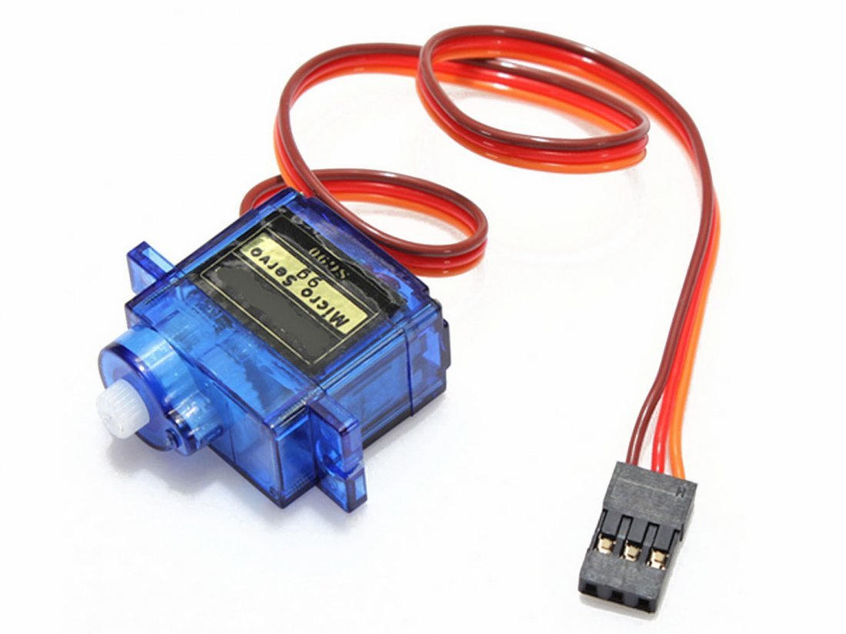
Servo Motor

Slide 22
Software Components
Software includes different application that controls every equipment's like electric bulb, fans, refrigerator, washing machine, camera surveillance, motor detector, tv, and so on.
It needs application to control the devices. The software includes are shown below:
Blink app

Slide 23
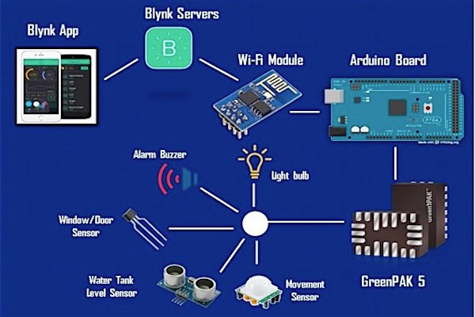
Software Components

Slide 24
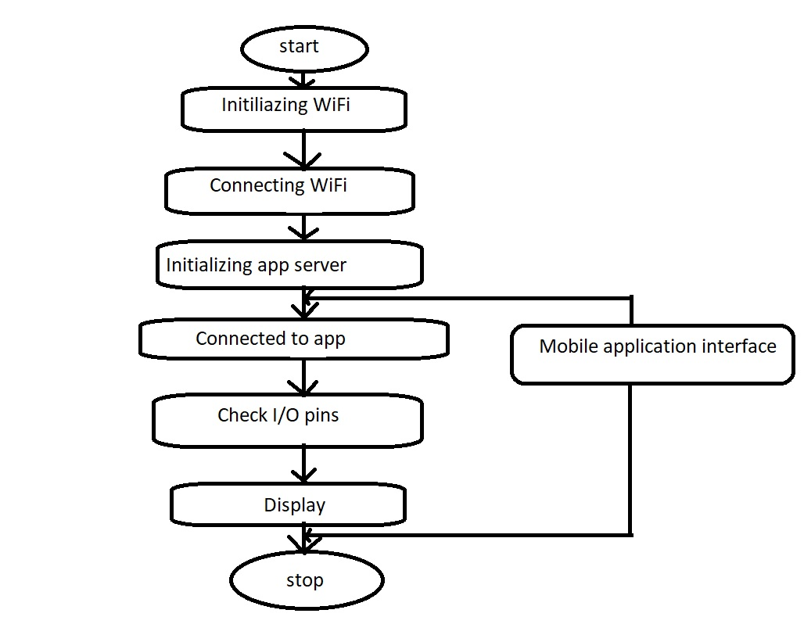
Flowchart
Flowchart of prototype function

Slide 25
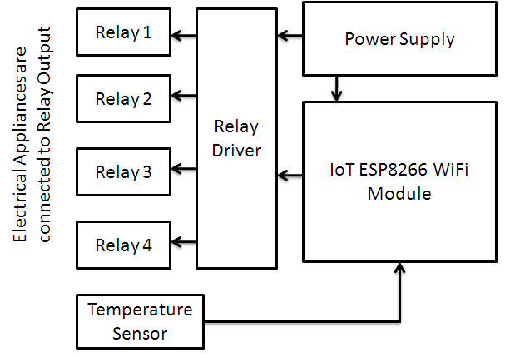
Overall Block Diagram

Slide 26
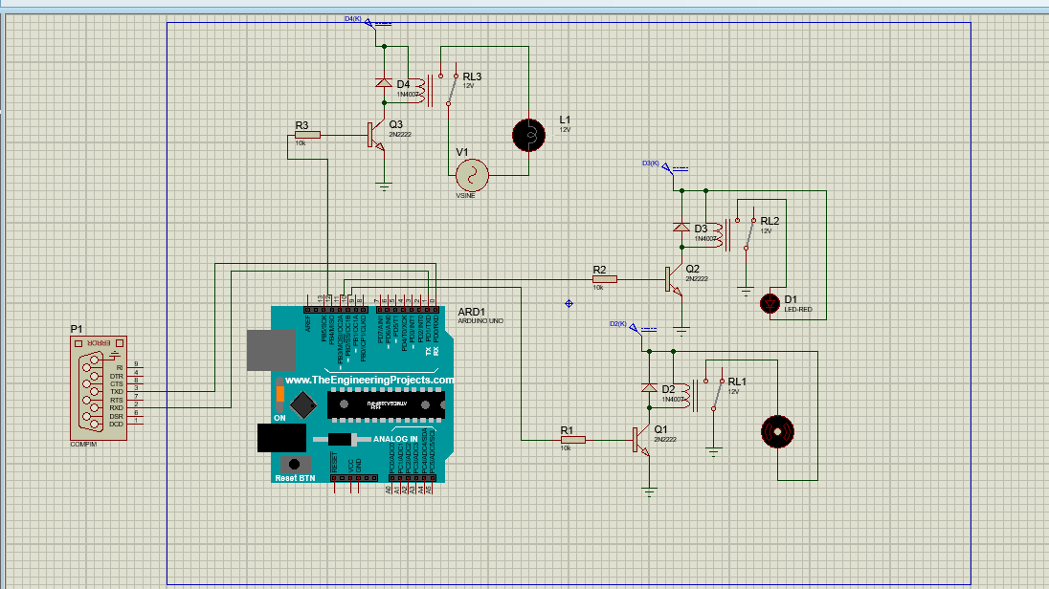
Simulation circuit of Home automation

Slide 27
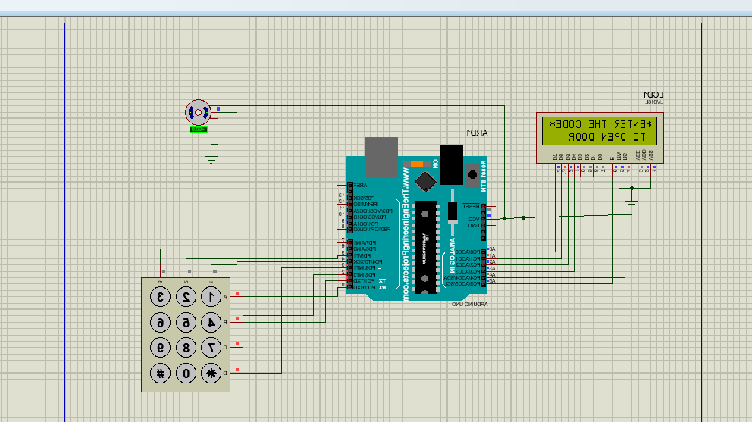
Simulation circuit of Automatic door opening system

Slide 28
Advantages
1. Managing all of your home from one place. This means we are able to control all of our home connected system through one interface and make easier to access to functionality which we want for our house.
2.It provides flexibility for using new devices and appliances of our home which is very impressive and allow us to keep upgrading with latest technology.
3. It provides security to your home . For example, home automation systems can connect motion detectors, surveillance cameras, automated door locks, and other tangible security measures throughout your home so you can activate them from one mobile device before heading to bed.

Slide 29
4. Remote control of home function. For e.g.; if we are late to go to home from work then we can preheat the oven before we reach home and if we do not turn off light on the front door and go away from home then also we can control.
5. Increased energy efficiency. E.g.: turning on light when you enter and turn off when you leave and never wasting any energy.
6. Home management insights. E.g.: how time the room of light is on and how much time tv is on and so on.
7. Improved appliance functionality. We may find great difference in using manual switch and controlling switch by using application.

Slide 30
Application
The most common applications of home automation are lighting control, HVAC, outdoor lawn irrigation, kitchen appliances, and security systems.
The application is based on the nature of person, the purpose for which home is used and other terms and condition.

Slide 31
Conclusion:
Truly, the home automation system is today modern culture. However it is limited to certain place in Nepal after the modernization and discovery in this twenty first century. It is very guilty for Nepal that our country has no such a simple project applied which is no more costy and helps to save time.
It is very much kidding to say that our country is forward in the field of science and technology.
It is like a lab activities that we performed in lab which we are lagging b behind to apply in our practical life to increase horizon of our knowledge.
.

Slide 32
It is very necessary for one to update in science and technology and adoption of technology and change with science and technology.
We have to adopt the technology and use it to become a practical and not only limit our knowledge in theoretical study but proper application leads to prosperous future of the prosperous Nepal.
No more to say , but home automation system is not a new project , it is very simple and adoptable and create a environment of science technology development in the field and discovery.

Slide 33
Budget
Node MCU RS 800(1pc)
Relay Module Rs 1000(1pc)(8 channel)
Electrical Components Rs 500
Battery Optional Rs 500
Arduino Uno Rs 1700
Servo Motor Rs 500
Keypad Rs 210

Slide 34
References:
https://www.Arduino.cc/en/Main/ArduinoBoardUno
http://www.instruconnect.net/Arduino
http://www.udemy.com/beginning-arduino
http://www.learningaboutelectronics.com/Articles/Atmeaga328-pinout.ph
https://www.ijcttjournal.org/2017/Volume47/number-1/IJCTT-V47P109.pdf

Slide 35
Any Queries?

Slide 36
Thank You.

